Slide 1
React
Lab Module 3

Slide 2
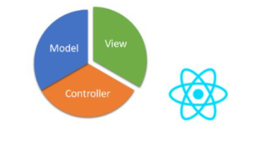
ReactJs
React is a JavaScript library - one of the most popular ones, with over 100,000 stars on GitHub.
React is not a framework (unlike Angular, which is more opinionated).
React is an open-source project created by Facebook.
React is used to build user interfaces (UI) on the front end.
React is the view layer of an MVC application (Model View Controller)
Routing-react router DOM
Website: https://reactjs.org/

Slide 3
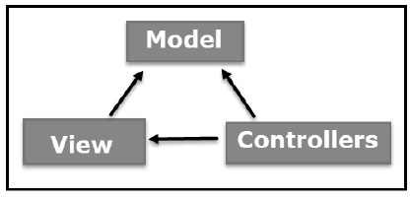
ReactJs
The Model-View-Controller (MVC) is an architectural pattern that separates an application into three main logical components: the model, the view, and the controller. Each of these components are built to handle specific development aspects of an application. MVC is one of the most frequently used industry-standard web development framework to create scalable and extensible projects

Slide 4
ReactJs
Model
The Model component corresponds to all the data-related logic that the user works with. This can represent either the data that is being transferred between the View and Controller components or any other business logic-related data. For example, a Customer object will retrieve the customer information from the database, manipulate it and update it data back to the database or use it to render data.

Slide 5
ReactJs
View
The View component is used for all the UI logic of the application. For example, the Customer view will include all the UI components such as text boxes, dropdowns, etc. that the final user interacts with.
Controller
Controllers act as an interface between Model and View components to process all the business logic and incoming requests, manipulate data using the Model component and interact with the Views to render the final output.

Slide 6
Why React?
Minimal server-side support dictated
Page is loaded automatically, by changing the DOM
Focus on supporting for programming in the large and single page applications
Easy creation of dynamic applications:, less coding and offers more functionality
Improved performance
React uses Virtual DOM, thereby creating web applications faster.
Virtual DOM compares the components’ previous states and updates only the items in the Real DOM that were changed
Notes:
https://www.netsolutions.com/insights/single-page-application/

Slide 7
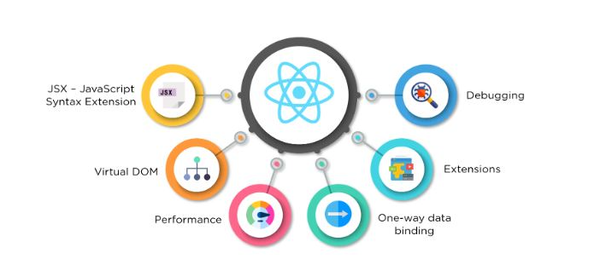
Reusable components:
Modules, reusable components, testing, etc
Small learning curve
It can be used for the development of both web and mobile apps
Dedicated tools for easy debugging

Slide 8
Installation
Install Nodejs
Node.js provides a runtime environment to execute JavaScript code from outside a browser. NPM, the Node package manager is used for managing and sharing the packages for either React or Angular.
NPM will be installed along with Nodejs. Node.js can be downloaded and installed from the official NodeJs website.

Slide 9
Installation
The next step is to install a tool called create-react-app using NPM. This tool is used to create react applications easily from our system. You can install this at the system level or temporarily at a folder level. We will install it globally by using the following command.
npm install -g create-react-app my-app
open powershell
node --version
npm --version

Slide 10
Installation
npx create-react-app my-app

Slide 11
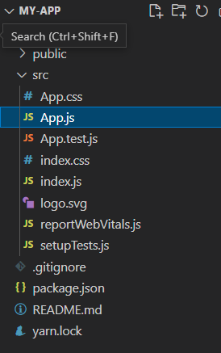
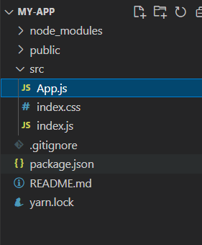
Clean up the project

Slide 12
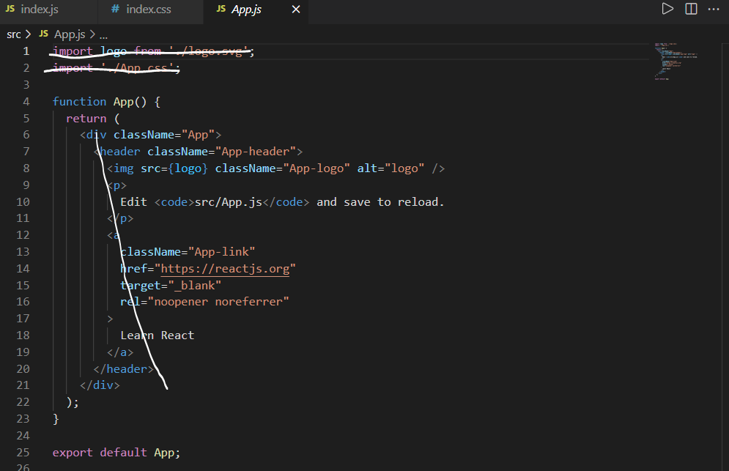
App.js
npm start

Slide 13
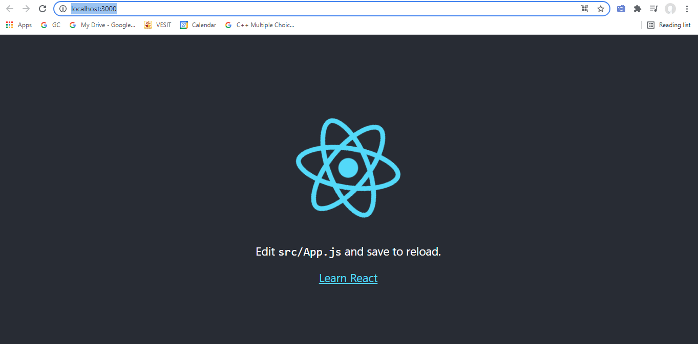
Development Server starts...

Slide 14
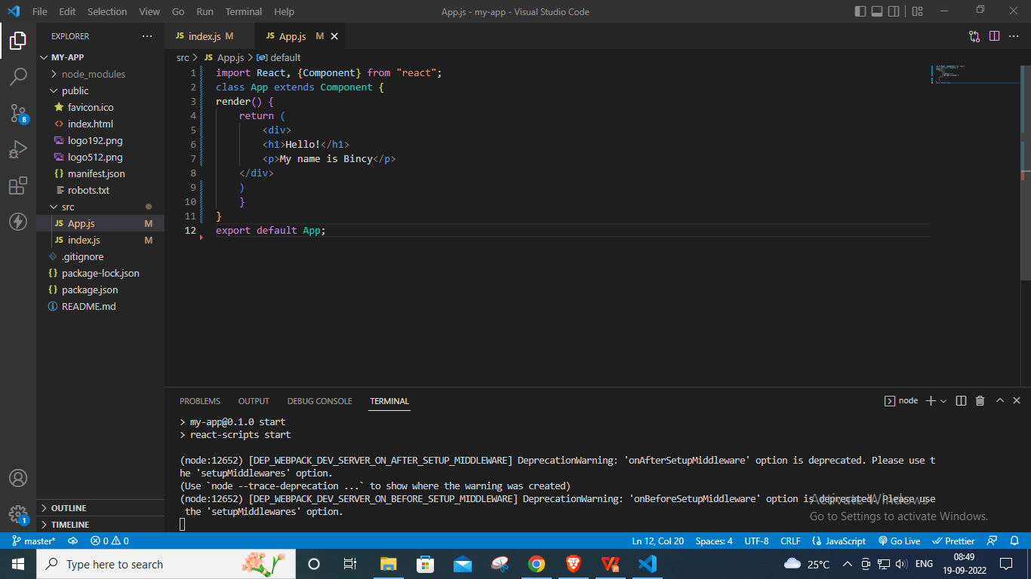

Slide 15
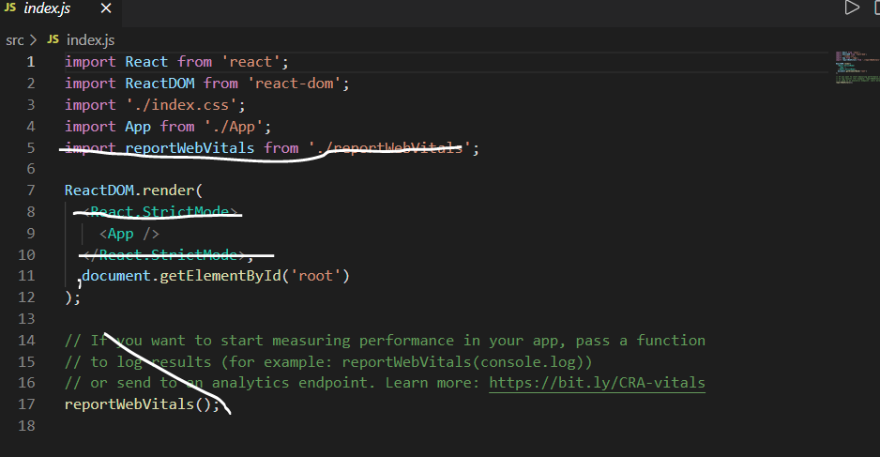
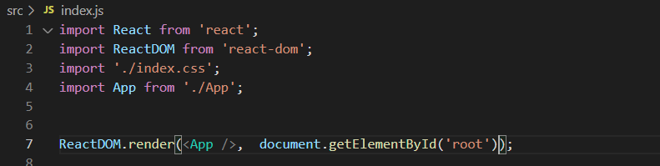

Slide 16
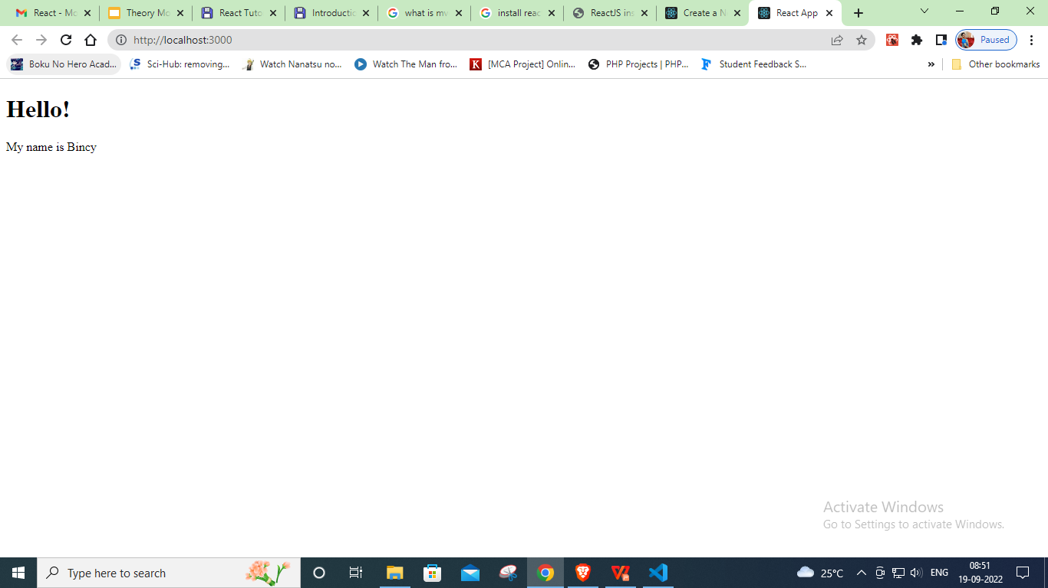

Slide 17
React splits application into components
Each component has a defined task
React library combines and renders on the browser
Follows Declarative approach
Single Page Application (SPA) are built
load on same page
Server sends only 1 HTML page
React controls and updation if at any later

Slide 18
The Document Object Model, usually referred to as the DOM, is an essential part of making websites interactive. It is an interface that allows a programming language to manipulate the content, structure, and style of a website. JavaScript is the client-side scripting language that connects to the DOM in an internet browser.

Slide 19
Almost any time a website performs an action, such as rotating between a slideshow of images, displaying an error when a user attempts to submit an incomplete form, or toggling a navigation menu, it is the result of JavaScript accessing and manipulating the DOM.

Slide 20
At the most basic level, a website consists of an HTML document. The browser that you use to view the website is a program that interprets HTML and CSS and renders the style, content, and structure into the page that you see.
In addition to parsing the style and structure of the HTML and CSS, the browser creates a representation of the document known as the Document Object Model. This model allows JavaScript to access the text content and elements of the website document as objects.

Slide 21
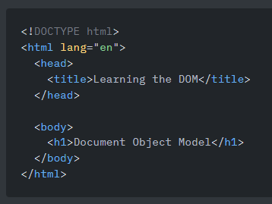
Create an index.html and save it in a new project directory.

Slide 22
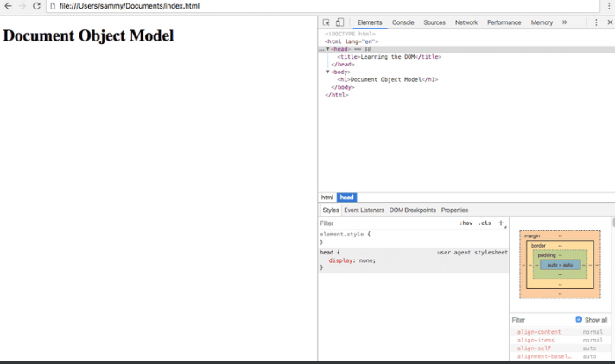
Open index.html with your browser of choice. You'll see a plain website with our heading displaying "Document Object Model". Right click anywhere on the page and select "Inspect". This will open up Developer Tools.
Under the Elements tab, you'll see the DOM.
In this case, it looks exactly the same as the HTML source code we just wrote - a doctype, and the few other HTML tags that we added.

Slide 23
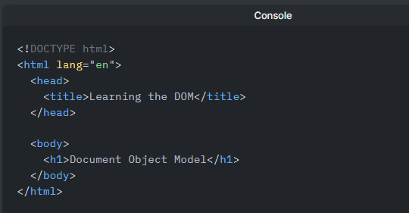
In Developer Tools on index.html, move to the Console tab. Type document into the console and press ENTER. You will see that what is output is the same as what you see in the Elements tab.

Slide 24
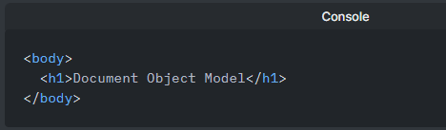
Currently, with this example, it seems that HTML source code and the DOM are the exact same thing. There are two instances in which the browser-generated DOM will be different than HTML source code:
The DOM is modified by client-side JavaScript
The browser automatically fixes errors in the source code
how the DOM can be modified by client-side JavaScript. Type the following into the console:
document.body;
The console will respond with this output:

Slide 25
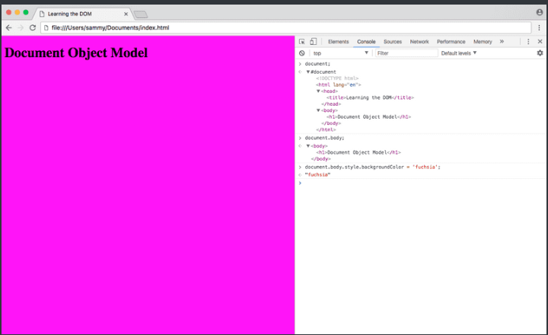
document is an object, body is a property of that object that we have accessed with dot notation. Submitting document.body to the console outputs the body element and everything inside of it.
In the console, we can change some of the live properties of the body object on this website. We'll edit the style attribute, changing the background color to fuchsia. Type this into the console:
document.body.style.backgroundColor = 'fuchsia';
After typing and submitting the above code, you'll see the live update to the site, as the background color changes.

Slide 26
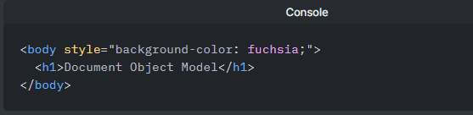
Switching to the Elements tab, or typing document.body into the console again, you will see that the DOM has changed.
The JavaScript code we typed, assigning fuchsia to the background color of the body, is now a part of the DOM.
However, right click on the page and select "View Page Source". You will notice that the source of the website does not contain the new style attribute we added via JavaScript. The source of a website will not change and will never be affected by client-side JavaScript. If you refresh the page, the new code we added in the console will disappear.

Slide 27
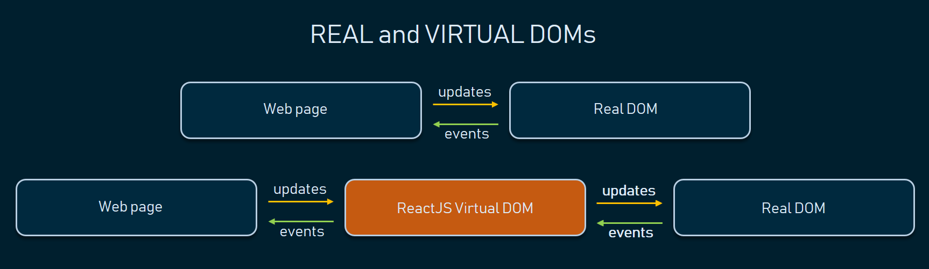

Slide 28
Virtual DOM: React uses Virtual DOM exists which is like a lightweight copy of the actual DOM(a virtual representation of the DOM).
So for every object that exists in the original DOM, there is an object for that in React Virtual DOM. It is exactly the same, but it does not have the power to directly change the layout of the document.
Manipulating DOM is slow, but manipulating Virtual DOM is fast as nothing gets drawn on the screen. So each time there is a change in the state of our application, the virtual DOM gets updated first instead of the real DOM.

Slide 29
As we have already seen that, all of the React components have a render function. The render function specifies the HTML output of a React component. JSX(JavaScript Extension), is a React extension which allows writing JavaScript code that looks like HTML. In other words, JSX is an HTML-like syntax used by React that extends ECMAScript so that HTML-like syntax can co-exist with JavaScript/React code. The syntax is used by preprocessors (i.e., transpilers like babel) to transform HTML-like syntax into standard JavaScript objects that a JavaScript engine will parse.
const name = 'Josh Perez';
const element = <h1>Hello, {name}</h1>;

Slide 30
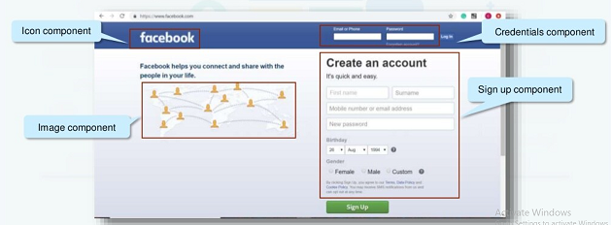
Components
Components are the building blocks of React application that represent a part of the user interface
Reusable

Slide 31
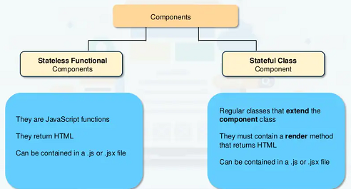
Types of Components in React

Slide 32
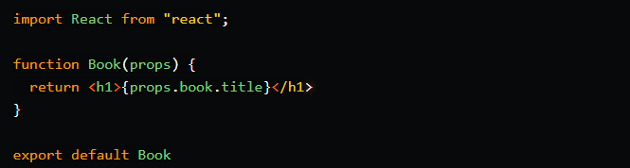
Types of Components in React
Function Component
Function components are the simplest way to write a component.

Slide 33
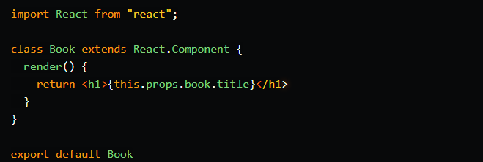
Class Component
Class components are defined using the ES6 class.
Unlike function components, class components use a render method to return JSX. A class component must have the render method.

Slide 34
When to use what?
Use function components when the component do simple tasks like display content.
But if we want to writing more business logic, need state, or making fetch request to an API, then use a class component. Also, if you need to use any lifecycle methods, function components do not have lifecycle methods.

Slide 35
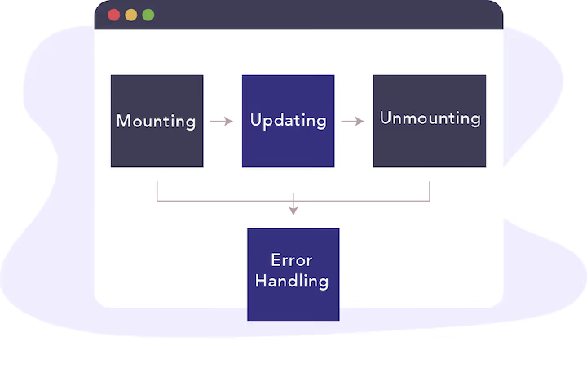
Life Cycle of Components
The React component goes through the following phases

Slide 36
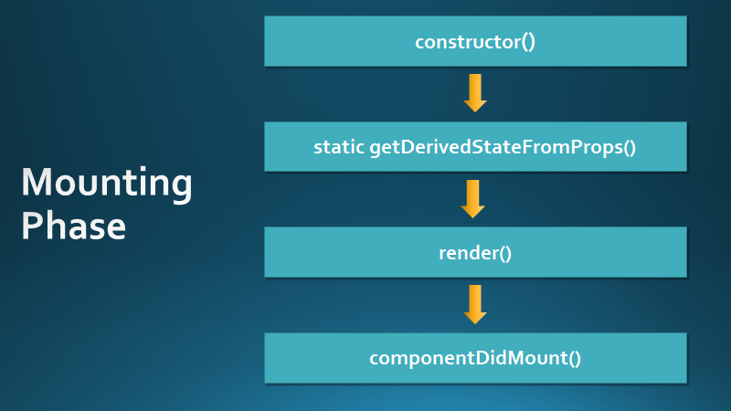

Slide 37
Mounting Phase
This phase refers to the component’s creation. This is where the component is added to the DOM.
constructor()
Before the start of the mounting phase, we may need to initialize our component using a constructor() method.
static getDerivedStateFromProps(): This method is invoked before the render function of the component (and before the initial mount).
This method allows a component to update its states based on changes to its props. It is rarely used

Slide 38
render()
The render() method is the only method that the component is required to have. It will always be called and its job is to mount the component to the DOM. The render() method can return any of the following:
React Elements: Written in JSX, these are the plain object that describes what we want the user to see
Arrays or Fragments: These allow you to return multiple React elements. Arrays are declared using [], and fragments can be declared by using empty tags <> </>
Plain numbers and strings

Slide 39
componentDidMount()
The last function in this phase is componentDidMount(). This method will be immediately invoked after the render function is executed. If we need to interact with the browser directly, this is where we do it.
We can make an API call and update the components state based on its response. We can fill in the content from data we load from another endpoint. Calling setState() should be used here as it will call the render function again and handle asynchronous processes like fetch requests.

Slide 40
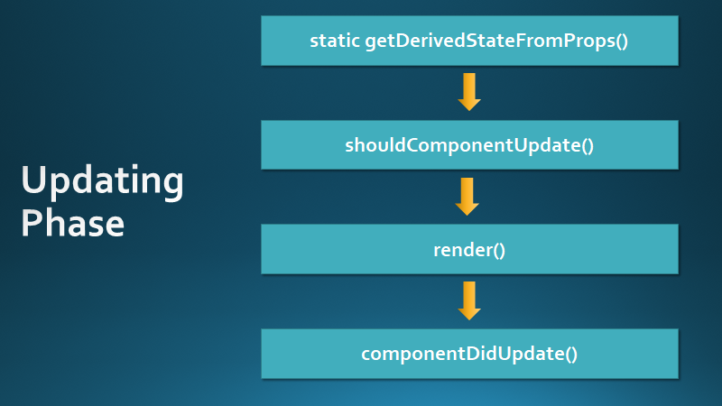

Slide 41
Updating
This second phase represents times where a component needs to update due to a change in its props or state. These changes can occur within the component or through the backend. These changes will trigger the render function again.
shouldComponentUpdate()
The next method to be invoked is the shouldComponentUpdate() method. As the name suggests, this method gives you control over whether or not a component should update due to a change in its props or state. By default, a component will always re-render when updated. This method can either return a true or false.
render()
If shouldComponentUpdate() returns true, the render function is invoked immediately.

Slide 42
getSnapshotBeforeUpdate()
In this method, we are given access to the props and state value before the update is committed to the DOM. Even though the render function was already called, we are still able to see the previous values.The use of this case is uncommon but can be used to capture any information we may need. It is important to note that this method works for hand in hand with componentDidUpdate()
componentDidUpdate()

Slide 43
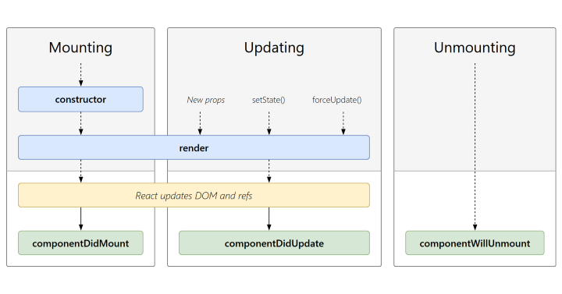

Slide 44
Unmounting
Finally, the unmounting phase is where the component is removed from the DOM. This marks the end of a component's lifecycle. In this phase, we have one lifecycle method available to us:
componentWillUnmount()
This method is executed right before the component is unmounted from the DOM. You can think of this method as a way to clean up anything that is needed to be removed before the component is destroyed.

Slide 45
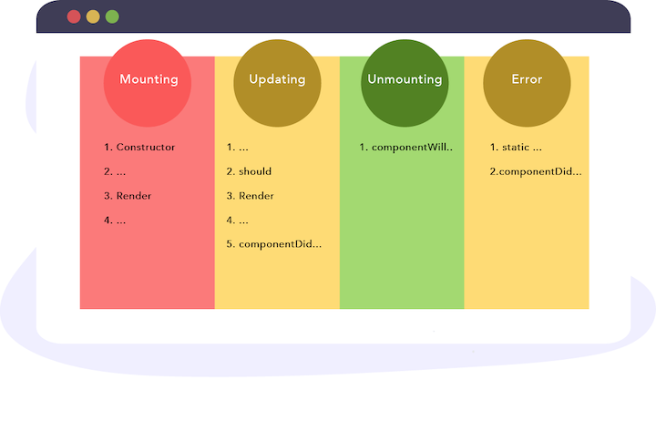

Slide 46
Updating: Updating is the stage when the state of a component is updated and the application is repainted.
Unmounting: As the name suggests Unmounting is the final step of the component lifecycle where the component is removed from the page.

Slide 47
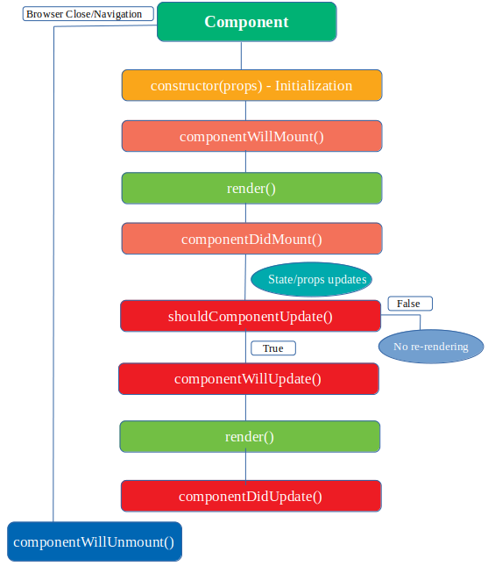

Slide 48
props
It is an object which stores the value of attributes of a tag
to create reusable custom components
Props are arguments passed into React components.
props stands for properties.
data with props are being passed in a unidirectional flow. (one way from parent to child)
Notes:
https://itnext.io/what-is-props-and-how-to-use-it-in-react-da307f500da0

Slide 49
props
import PropTypes from 'prop-types';
function Car(props) {
return <h2>I am a { props.brand }</h2>;
Car.propTypes = {
title: PropTypes.string.isRequired
};
Car.defaultProps = {
title: 'Default'
};
}
function Garage() {
return (
<>
<h1>Who lives in my garage?</h1>
<Car brand="Ford" />
</>
);
}
Notes:
https://itnext.io/what-is-props-and-how-to-use-it-in-react-da307f500da0

Slide 50
props
Sending Variable
function Car(props) {
return <h2>I am a { props.brand }</h2>;
}
function Garage() {
const carName = "Ford";
return (
<>
<h1>Who lives in my garage?</h1>
<Car brand={ carName } />
</>
);
}
Notes:
https://itnext.io/what-is-props-and-how-to-use-it-in-react-da307f500da0

Slide 51
props
function Car(props) {
return <h2>I am a { props.brand.model }!</h2>;
}
function Garage() {
const carInfo = { name: "Ford", model: "Mustang" };
return (
<>
<h1>Who lives in my garage?</h1>
<Car brand={ carInfo } />
</>
);
}
Notes:
https://itnext.io/what-is-props-and-how-to-use-it-in-react-da307f500da0

Slide 52
state
State is a plain JavaScript object used by React to represent an information about the component’s current situation
stores component’s dynamic data and it enables a component to keep track of changes between renders.
to change what is happening on the screen
A state can be modified based on user action or network changes

Slide 53
A component’s state can change over time; whenever it changes, the component re-renders. The change in state can happen as a response to user action or system-generated events and these changes determine the behavior of the component and how it will render.
Every time the state of an object changes, React re-renders the component to the browser

Slide 54
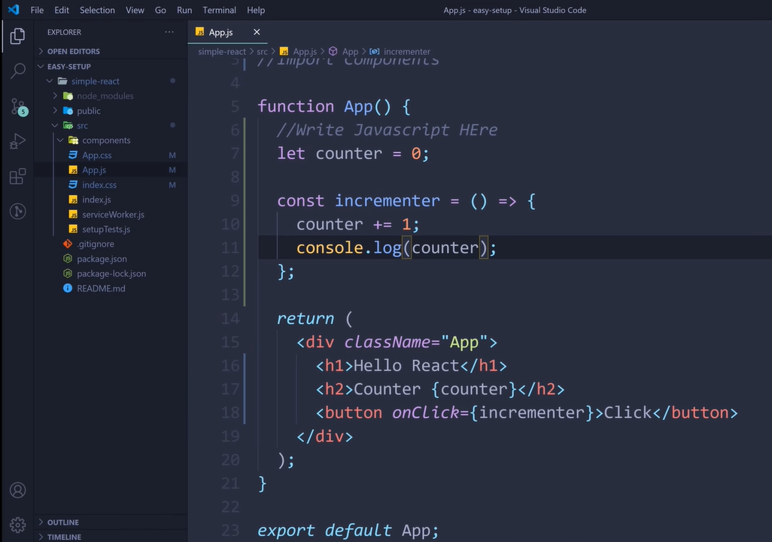
state

Slide 55
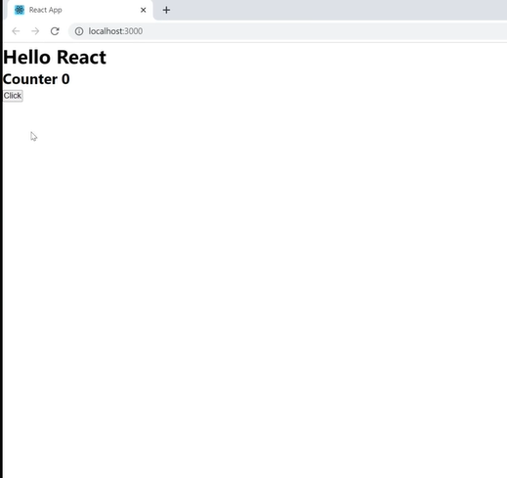
state

Slide 56
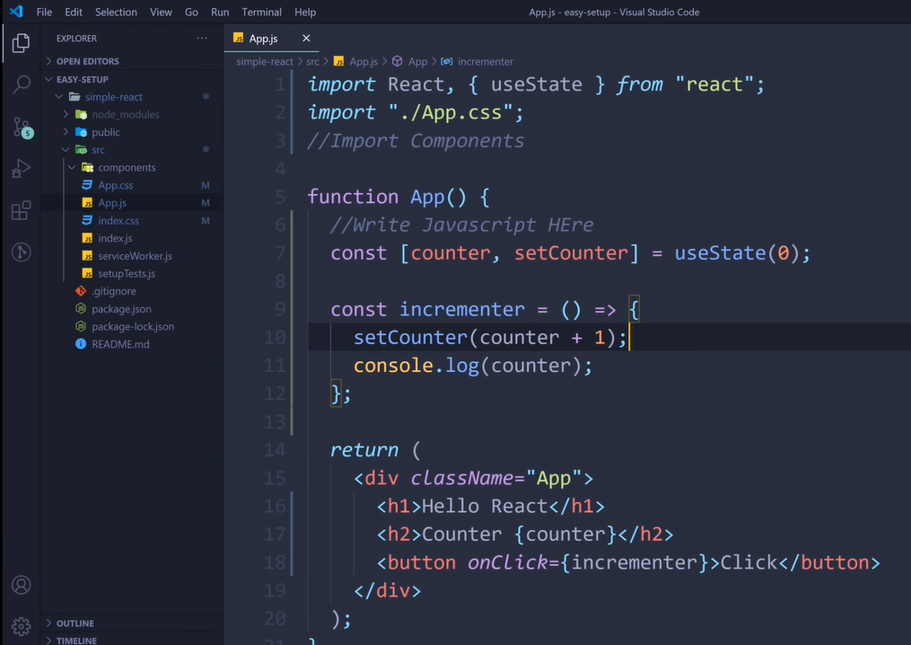
state

Slide 57
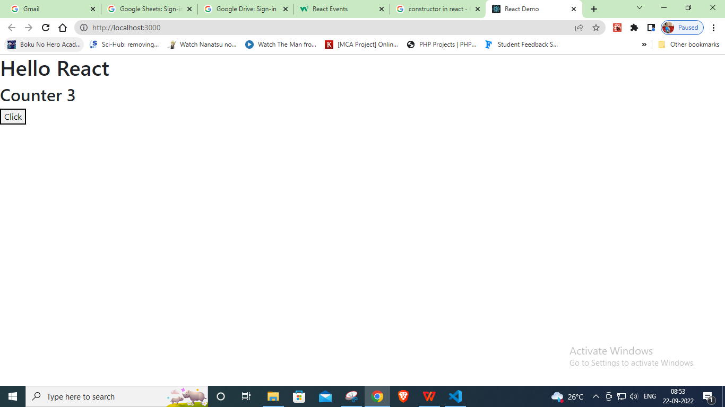
state

Slide 58
Events
Similar to handling events on DOM elements.
There are some syntax differences:
React events are named using camelCase, rather than lowercase.
(onClick instead of onclick)
With JSX you pass a function as the event handler, rather than a string.
React event handlers are written inside curly braces:
(onClick={shoot} instead of onClick="shoot()")
To pass an argument to an event handler, use an arrow function.

Slide 59
Events
function Football() {
const shoot = () => {
alert("Great Shot!");
}
return (
<button onClick={shoot}>Take the shot!</button>
);
}
const root = ReactDOM.createRoot(document.getElementById('root'));
root.render(<Football />);

Slide 60
Routing and SPA
React Router
Routing is a process in which a user is directed to different pages based on their action or request. ReactJS Router is mainly used for developing Single Page Web Applications. React Router is used to define multiple routes in the application. When a user types a specific URL into the browser, and if this URL path matches any 'route' inside the router file, the user will be redirected to that particular route

Slide 61
Routing and SPA
React Router is a standard library system built on top of the React and used to create routing in the React application using React Router Package. It provides the synchronous URL on the browser with data that will be displayed on the web page. It maintains the standard structure and behavior of the application and mainly used for developing single page web applications.

Slide 62
Routing and SPA
Need of React Router
React Router plays an important role to display multiple views in a single page application. Without React Router, it is not possible to display multiple views in React applications. Most of the social media websites like Facebook, Instagram uses React Router for rendering multiple views.
React Router Installation
npm install react-router-dom

Slide 63
Forms
How to Create Forms with Plain React
Here’s the first iteration, a standalone component called ContactForm that renders a form:

Slide 64
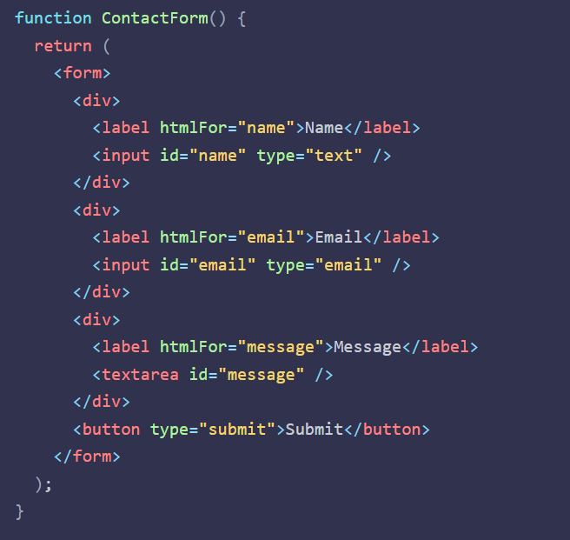

Slide 65
Forms
You don’t need to install a library to do any of this. React has built-in support for forms, because HTML and the DOM have built-in support for forms. At the end of the day, React is rendering DOM nodes.
In fact, for small forms, you probably don’t need a form library at all. Something like Formik or react-hook-form is overkill if all you need is a simple form.

Slide 66
Forms
There’s no state in here yet, and we’re not responding to form submission, but this component will already render a form you can interact with. (If you submit it, the page will reload, because submission is still being handled in the default way by the browser)

Slide 67
Forms
React Forms vs. HTML Forms
If you’ve worked with forms in plain HTML, a lot of this will probably seem familiar.
There’s a form tag, and labels for the inputs, same as you’d write in HTML.
Each label has an htmlFor prop that matches the id on its corresponding input. (That’s one difference: in HTML, the label attribute would be for. React uses htmlFor instead.)

Slide 68
Forms
Handling Forms
Handling forms is about how you handle the data when it changes value or gets submitted.
In HTML, form data is usually handled by the DOM.
In React, form data is usually handled by the components.
When the data is handled by the components, all the data is stored in the component state.
You can control changes by adding event handlers in the onChange attribute.
We can use the useState to keep track of each inputs value and provide a "single source of truth" for the entire application.

Slide 69
Forms
Two Kinds of Inputs: Controlled vs. Uncontrolled
Inputs in React can be one of two types: controlled or uncontrolled.
An uncontrolled input is the simpler of the two. It’s the closest to a plain HTML input. React puts it on the page, and the browser keeps track of the rest. When you need to access the input’s value, React provides a way to do that. Uncontrolled inputs require less code, but make it harder to do certain things.

Slide 70
Forms
With a controlled input, YOU explicitly control the value that the input displays. You have to write code to respond to keypresses, store the current value somewhere, and pass that value back to the input to be displayed. It’s a feedback loop with your code in the middle. It’s more manual work to wire these up, but they offer the most control.

Slide 71
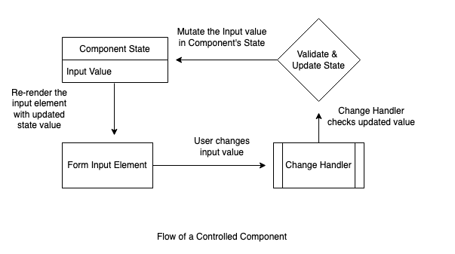
Forms
Controlled Inputs
With a controlled input, you write the code to manage the value explicitly.
You’ll need to create state to hold it, update that state when the value changes, and explicitly tell the input what value to display.

Slide 72
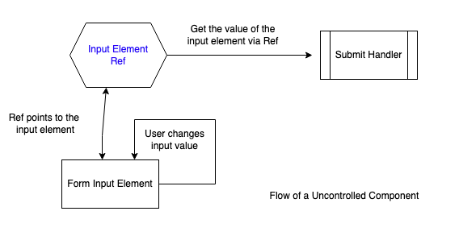
Forms
Uncontrolled Inputs
If you do nothing beyond dropping an <input> in your render function, that input will be uncontrolled. You tell React to render the input, and the browser does the rest.
Uncontrolled inputs manage their own value. Just like with a plain HTML form, the value is kept in the input’s DOM node. No need to manually track it.

Slide 73
Forms
In the first code sample on this page, all the inputs were uncontrolled, because we weren’t passing the value prop that would tell them what value to display.
But if we’re not actively tracking the value… how can we tell what the value is?
Here’s where “refs” come in.

Slide 74
Forms
What is a “ref”?
React takes your JSX and constructs the actual DOM, which the browser displays. Refs tie these two representations together, letting your React component get access to the DOM nodes that represent it.
A ref holds a reference to a DOM node.
Here’s why that matters: The JSX you write is merely a description of the page you want to create. What you really need is the underlying DOM input, so that you can pull out the value.
So, to get the value from an uncontrolled input, you need a reference to it, which we get by assigning a ref prop. Then you can read out the value when the form is submitted (or really, whenever you want!).

Slide 75
Material UI
React.js is one of the leading frameworks used when creating web applications. It enables developers to create highly-interactive components. React.js features also boost maintenance and overall productivity. The integration of the Material UI library in React.js projects takes things to a new level.

Slide 76
Material UI
Material-UI is simply a library that allows us to import and use different components to create a user interface in our React applications. This saves a significant amount of time since the developers do not need to write everything from scratch.
Material-UI widgets are heavily inspired by Google’s principles on building user interfaces. It is, therefore, easy for developers to build visually-appealing applications. You can learn more about Google’s material design principles from here.

Slide 77
Animation
Animation in ReactJs app is a popular topic and there are many ways to create different types of animations.Many developers create animation exclusively using css and adding classes to HTML tags. This is a great way and you should use it.

Slide 78
Animation
CSS method
React-transition-group — It is an add-on component for a simple implementation of basic CSS animations and transitions.
react-animations — React-animations implements all animations from animate.css. Simple to use!
React Reveal — This is an animation framework for React.

Slide 79
Animation
CSS method
This method is one of the best for a simple animation. When you use it instead of importing javascript libraries, your bundle remains small. And browser spends fewer resources. These two points also largely impact app productivity. If you have a simple animation and worry about the size of your bundle pay attention to this method.

Slide 80
Animation
React Transition Group is a library that allows you to add animation on a component or multiple components' entrance and exit.
React Transition Group does NOT do the animation for you, that is it does not provide the animation. It facilitates adding the animation either through CSS classes or styles when a component enters or exits.

Slide 81
Animation
React Transition Group exposes the components that will allow you to easily do that. There are 4 components that it exposes: Transition, CSSTransition, SwitchTransition, and TransitionGroup.

Slide 82
Animation
React-animations
React-animations — the library is built on all animations with animate.css. It is easy to use and has a lot of animation collections. React-animation works with any inline style library that supports the use of objects to define keyframe animations, such as Radium, Aphrodite or styled-components. I prefer to use the styled-components.

Slide 83
Animation
React-reveal
React Awesome Reveal is a library for React apps that provides a set of curated animated primitives. They can be used to add revealing animations to your components when they enter the browser viewport as the user scrolls the page.
This project was initially born as a modern (and more performant) replacement for react-reveal, which has been discontinued.

Slide 84
Best Practices
File Organization
Keep the components small
DRY (Don't Repeat Yourself)
SRP (Single responsibility principle) describes how to split requirements into components, encapsulation describes how to organize these components, and composition describes how to glue the whole system back.
Notes:
https://towardsdatascience.com/react-best-practices-804def6d5215

